Slide 1




Slide 2

PERCENTAGES-2

Slide 3

Test time on : Parajumbles
QR CODE:

Slide 4
Concepts
Percentage is one topic that uses Arithmetic essentially.
It essentially is the first topic that you study and is the topic that finds near universal application.
In fact, right from our childhood, we have been calculating percentages in some form or the other and percentages form a ubiquitous part of our everyday lives.
By solving these percentage questions, you learn the basic applications for this topic and how does this topic appear in different exams.

Slide 5
Question: 01
A report consists of 20 sheets each of 55 lines and each such line consists of 65 characters. This report is reduced onto sheets each of 65 lines such that each line consists of 70 characters. The percentage reduction in number of sheets is closest to:
(a) 20%
(b) 5%
(c) 30%
(d) 35%

Slide 6
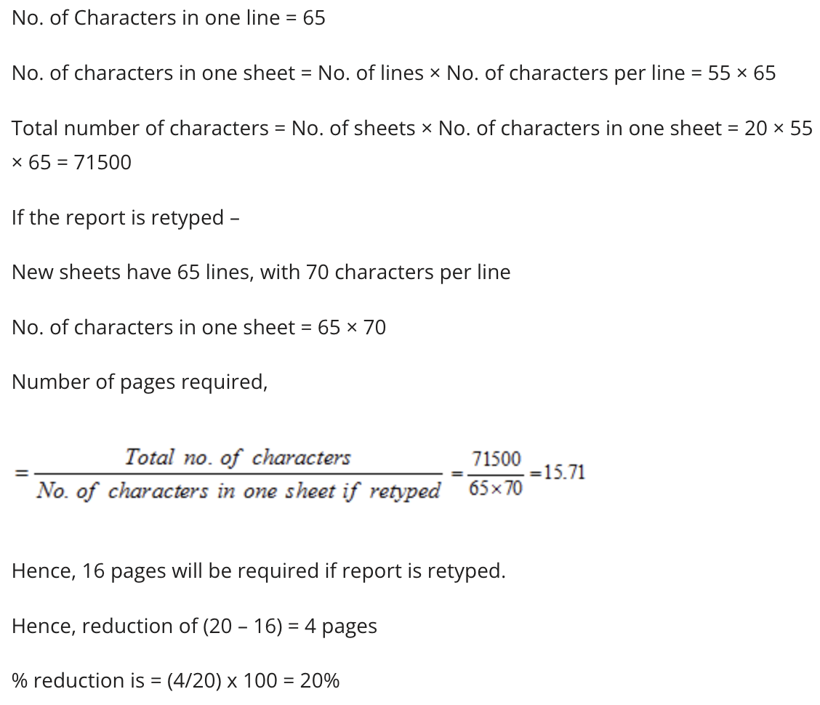
CLOCKS
Explanation: 01

Slide 7
Question: 02
The number of votes not cast for the PNC Party increased by 25% in the National General Election over those not cast for it in the previous Assembly Polls, and the PNC Party lost by a majority twice as large as that by which it had won the Assembly Polls. If a total 2,60,000 people voted each time, how many voted for the PNC Party in the previous Assembly Polls?
(a) 1,10,000
(b) 1,50,000
(c) 1,40,000
(d) 1,20,000

Slide 8
Explanation: 02
Total Votes = 2,60,000
Let x voters voted against the party in the Assembly Poll.
Then votes in favour = 260000 – x
Therefore, majority of votes by which party won in previous poll = 260000– x – x = 260000 – 2x
Next year votes against the PNC party increase by 25%
So, votes against the party in general election = 1.25 x
And votes polled in favour of the party = total votes – votes against = 260000 – 1.25x
Therefore, majority of votes by which party lost in general election
= 1.25x – (260000 – 1.25x) = 2.5x – 260000
It is given that, PNC Party lost by a majority twice as large as that by which it had won the Assembly Polls, Therefore
2.5x – 260000 = 2(260000 – 2 x)
⇒ 2.5x – 260000 = 2 260000 – 4x
⇒ 6.5x = 3260000⇒x == 1,20,000
Therefore, votes polled by the voters for the party in Assembly Polls for previous year
= (2,60,000 – x) = (2,60,000 – 1,20,000) = 1,40,000.

Slide 9

Question: 03
2/5th of the voters promise to vote for A and the rest promised to vote for B. Of these, on the last day 15% of the voters went back of their promise to vote for A and 25% of voters went back of their promise to vote for B, and A lost by 200 votes. Then, the total number of voters is:
(a) 10000
(b) 11000
(c) 9000
(d) 9500

Slide 10
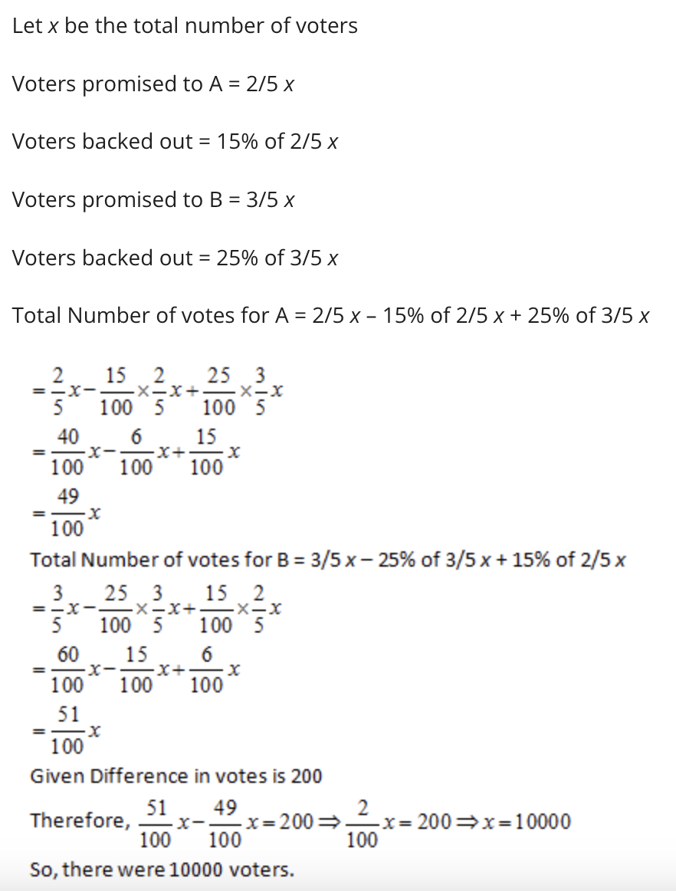
Question: 01
Explanation: 03

Slide 11
Question: 04
A person who has a certain amount with him goes to market. He can buy 50 oranges or 40 mangoes. He retains 10% of the amount for taxi fares and buys 20 mangoes and of the balance, he purchases oranges. Number of oranges he can purchase is:
(a) 36
(b) 40
(c) 15
(d) 20

Slide 12
Explanation: 04
The person can buy 50 oranges or 40 mangoes.
Let the price of one orange be Rs. x
Total amount the person has = Rs. 50x
40 mangoes cost 50x, So one mango costs 1.25x
10% of the total amount is retained for taxi fare = 10% of 50x = 5x
20 mangoes bought for 20 x 1.25x = 25x
Money left with the person = 50x – (Taxi fare) – (Mangoes cost)
= 50x – 5x – 25x = 20x
One Orange was for Rs. x, Therefore, 20 oranges can be bought with Rs. 20 x
Thus, the person bought 20 oranges.

Slide 13
Question: 16
Question: 05
Forty per cent of the employees of a certain company are men and 75% of the men earn more than Rs. 25,000 per year. If 45% of the company’s employees earn more than Rs. 25,000 per year, what fraction of the women employed by the company earn Rs. 25,000 or less per year?
(a) 2/11
(b) 1/4
(c) 1/3
(d) 3/4

Slide 14
Question: 09
Explanation: 05
Let the total number of employees in the company be x
Then the number of men and women be 0.4x and 0.6x respectively.
75% of men earn more than Rs. 25000 => 0.75 x 0.4 x = 0.3 x
Total number of employees earning more than Rs. 25000 = 45% x = 0.45 x
Number of women earning more than Rs. 25000 =
Total employees earning more than Rs. 25000 – total number of Men earning more than Rs. 25000
= 0.45 x – 0.30 x = 0.15 x
Number of the women earning Rs. 25000 or less = 0.60 x – 0.15 x = 0.45 x
Fraction of the women employed by the company who earn Rs. 25000 or less
(0.45x/0.60x) = 45/60 = ¾
Alternate Solution:
Let there are 40 men and 60 women in the company. Now out of 40 men, 75% i.e. 30 earn more than Rs 25000 and 45% of the total employees i.e. 45 employees earn more than Rs 25000.
Hence, there are
45 – 30 = 15 women who earn more than Rs25000. So, 60 – 15 = 45 women earn less than Rs 25000.
Hence, the required fraction = 45/60 = ¾

Slide 15
Question: 02
Question: 06
Class B has 50% more students than class A. Number of girls in class A is equal to number of boys in class B. The percentage of girls is the same in both classes. What percentage of the student group are boys?
33.33%
40%
25%
60%

Slide 16
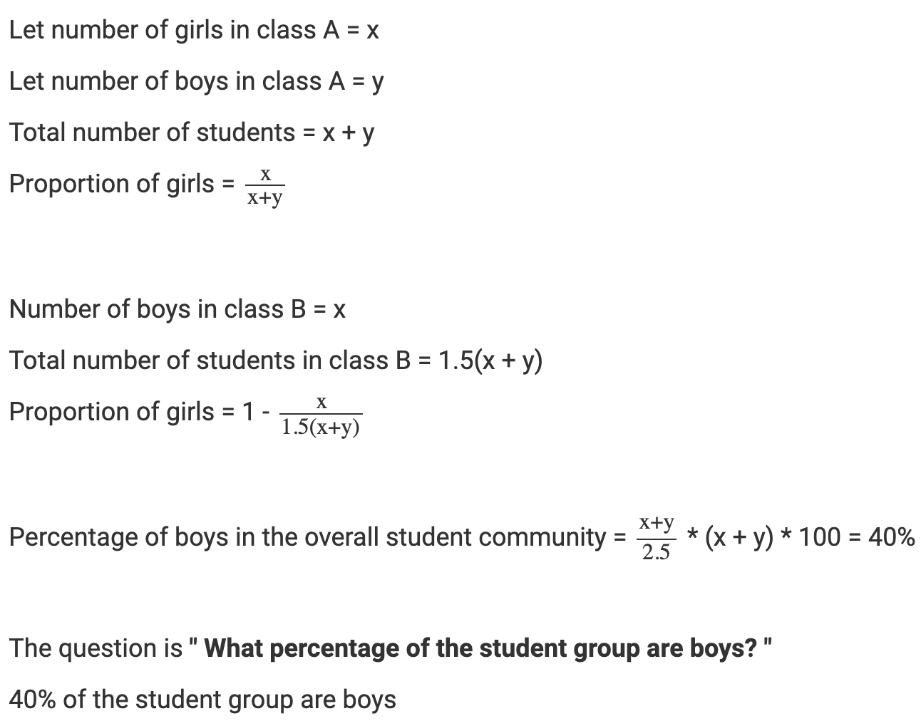
Explanation: 06
50% more than x is 1.5x. Simple, but very useful idea that might help you in solving these kinds of problems.

Slide 17
Question: 07
a is x % of b, b is x% more than a. Find x.
50%
62%
75%
37%

Slide 18
Explanation: 07
The golden ratio idea is so interesting that we have repeated it.
a = bx
b = a (1 + x), substituting this in the previous equation, we get
x (x + 1) = 1
x2 + x - 1 = 0 or
x is approximately 0.62 or 62%. The ratio 1.618 is also called the golden ratio, and is the conjugate and reciprocal of 0.618.
Hence, the answer is 62%

Slide 19
Question: 04
Question: 08
A batsman scored 110 runs which included 3 boundaries and 8 sixes. What percent of his total score did he make by running between the wickets?
A. 45%
B. 55%
C. 45 5/11 %
D. 54 6/11 %

Slide 20
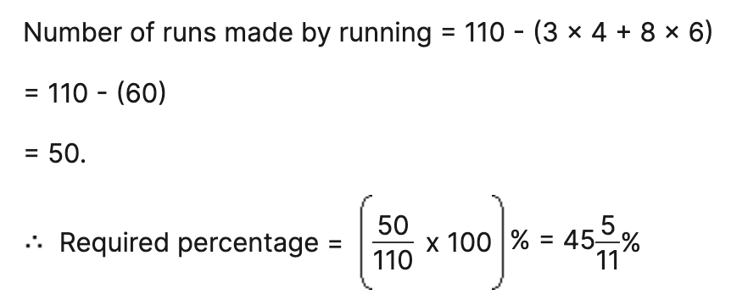
Explanation: 08

Slide 21
Question: 05
Question: 09
The population of a town increased from 1,75,000 to 2,62,500 in a decade. The average percent increase of population per year is:
4.37%
6%
5%
8.75%

Slide 22
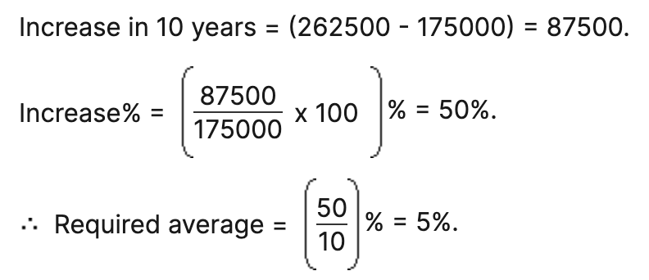
Explanation: 09

Slide 23
Question: 10
Gauri went to the stationers and bought things worth Rs. 25, out of which 30 paise went on sales tax on taxable purchases. If the tax rate was 6%, then what was the cost of the tax free items?
15
15.7
20
19.7

Slide 24

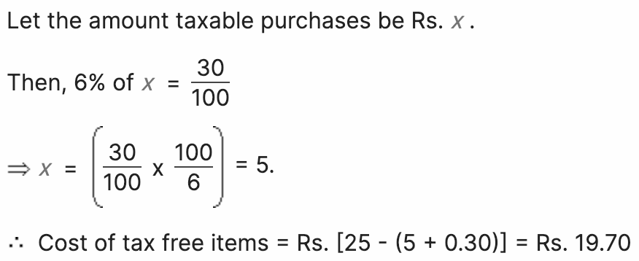
Explanation:
Explanation: 10

Slide 25
Question: 11
In a factory, there are equal number of women and children. Women work for 6 h a day and children for 4 h a day. During festival time, the work load goes up by 50%. The government rule does not allow children to work for more than 6 h a day. If they are equally efficient and the extra work is done by women, then extra hours of work put in by women everyday are
A. 5
B. 3
C. 4
D. 9

Slide 26
Explanation:
Explanation: 11
Let extra hours a day are x.
According to the formula,
M1D1T1/W1 = M2D2T2/W2
1*1*(6+4)/1 = 1*1*(6+6+X/ 1(½)
3/2*10=12+X
15 = 12+x
x = 15-12=3
Extra hours of work everyday are 3

Slide 27
Question: 08
Question: 12
Three candidates contested an election and received 1136, 7636 and 11628 votes respectively. What percentage of the total votes did the winning candidate get?
60%
65%
57%
90%

Slide 28
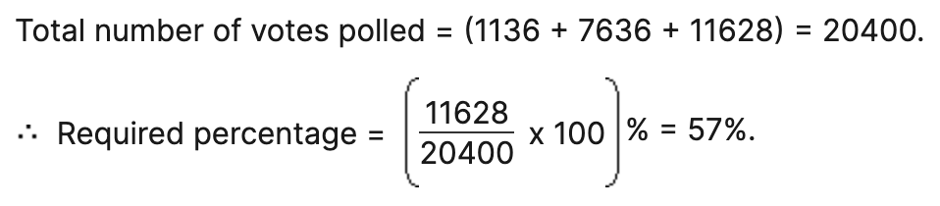
Explanation:
Explanation: 12

Slide 29
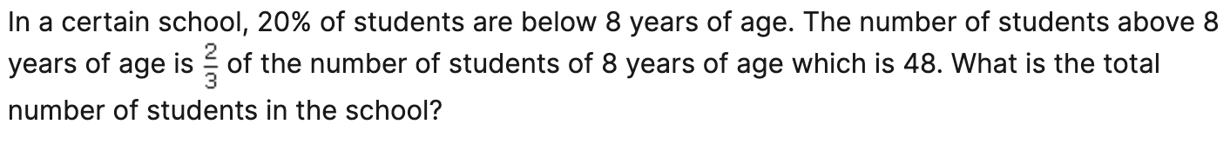
Question: 09
Question: 13
A. 72
B. 68
C. 150
D. 100

Slide 30
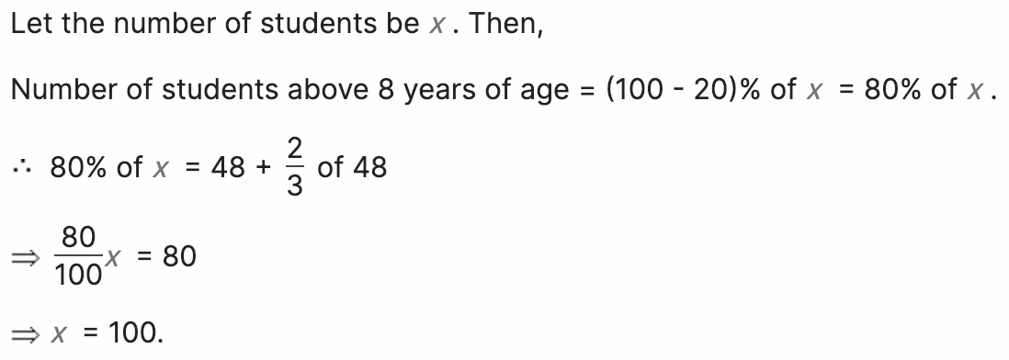
Question: 09
Explanation: 13

Slide 31
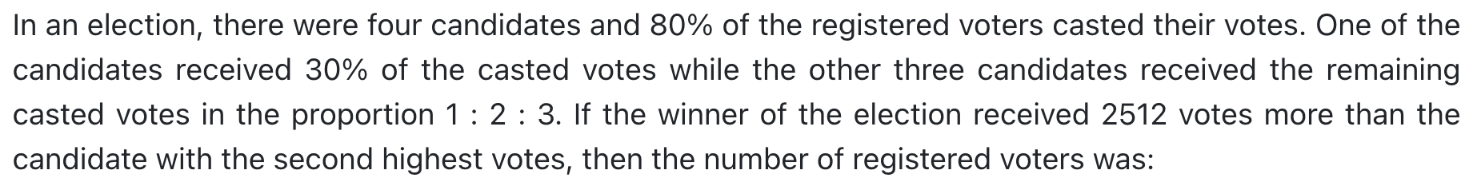
Question: 14
60188
62800
50240
40192

Slide 32
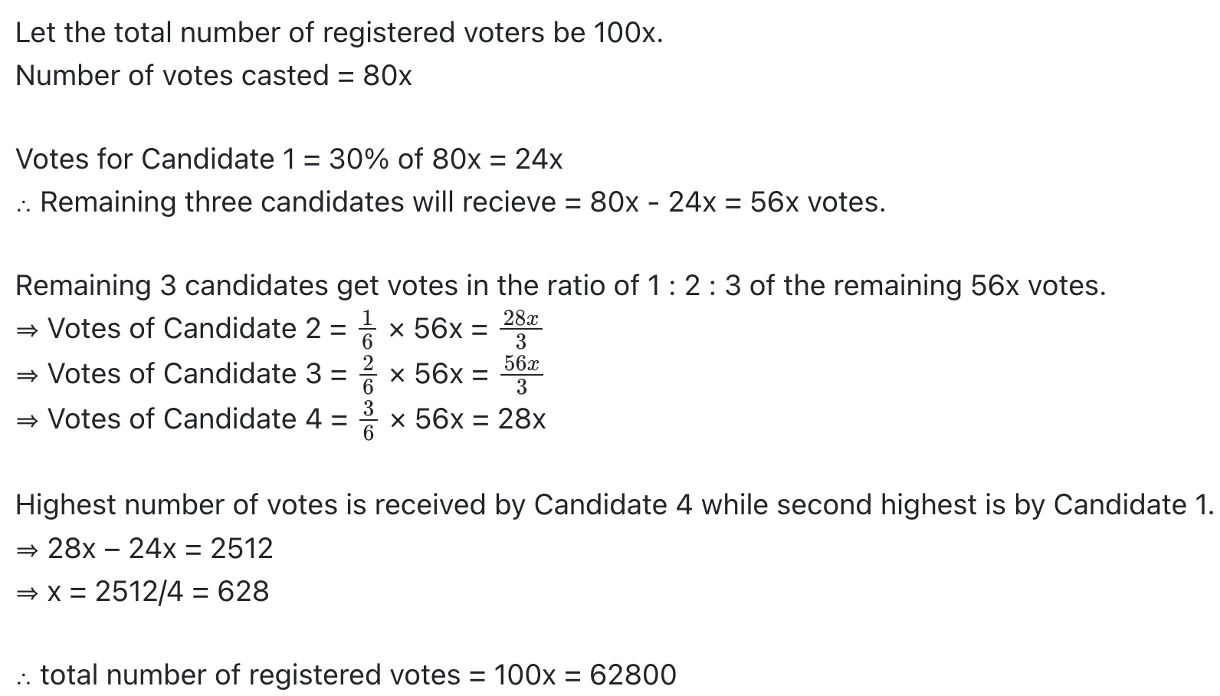
Explanation:
Explanation: 14

Slide 33
Question: 11
Question: 15
A.84
B.78
C.72
D.80

Slide 34
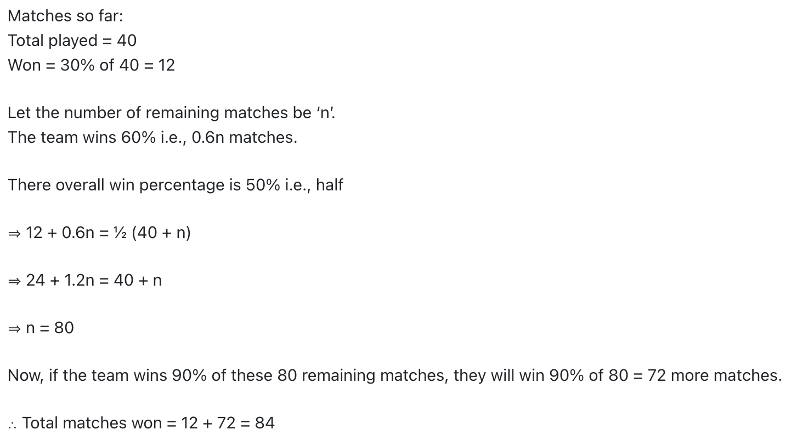
Question: 09
Explanation: 15

Slide 35




THANK YOU
+91 78150 95095
codemithra@ethnus.com
www.codemithra.com

